Slide 1

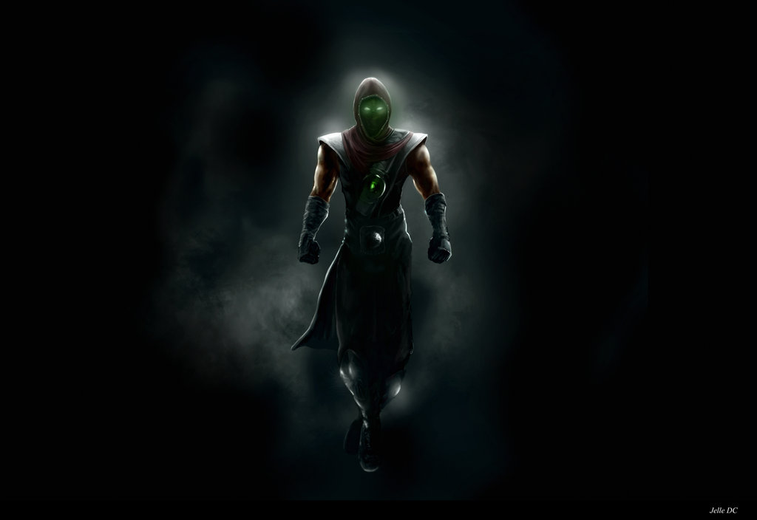
Teamwork project - JS UI & DOM 2014, July
http://academy.telerik.com
Client-side JavaScript application
Team Ermac

Slide 2

Starring
Human Resources

Slide 3
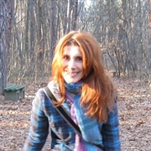
Collaborator
Names | Irina Kezhova
Main Project Role | Excuses finder
Additional Roles | Not available
Profile avatar

Slide 4

Collaborator
Names | Dzhenko Penev
Main Project Role | Architecture Design (OOP)
Additional Roles | One man army
Profile avatar

Slide 5
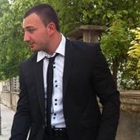
Collaborator
Names | Zhiko Mitov
Main Project Role | Algorithms
Additional Roles | Requirements, Specifications
Profile avatar

Slide 6
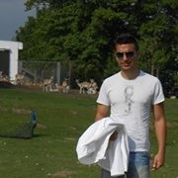
Collaborator
Names | Teodor Mihov
Main Project Role | KineticJS graphic
Additional Roles | Algorithms, Coordination
Profile avatar

Slide 7
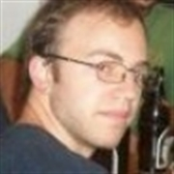
Collaborator
Names | Marko Kalaksyzov
Main Project Role | UI
Additional Roles | Requirements, Support
Profile avatar

Slide 8
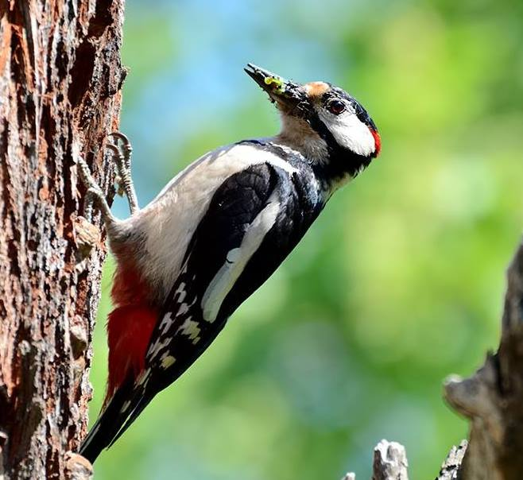
Collaborator
Names | Meroslav Tsaakoff
Main Project Role | SVG Animations
Additional Roles | Documentation
Profile avatar

Slide 9

Project Realization
Description, Implementation

Slide 10
Description
Summary
The main goal of the game is to fly with a spaceship as long as it’s possible.
Project opportunities
Easy to Implement logic
Many possibilities for all kind of features, animations, conditions and so on.

Slide 11
Requirements
HTML5 Canvas | Achieved
SVG | Achieved
Git repository | Achieved
jQuery | Achieved
Unit-tests | Achieved
OOP | Achieved

Slide 12
Team Contribution
Git
~70 commits, participated by almost every one in the team acting in any hour in the day and night
https://github.com/mitov90/BrainGame
Facebook
Polls for the most important decisions
Pictures from the offline meeting
Files and opinions transfers
https://facebook.com/groups/575414105908875/

Slide 13
Brain Game
Live Demo

Slide 14
CatchBall Realization
?
?
?
?
?
Questions?
?
?
?
?
?
http://academy.telerik.com

